Slide 1
[ SPACE RESERVED FOR SRM ONLINE LOGO ]
Candidate will paste the official SRM Online insignia here
DIRECTORATE OF ONLINE EDUCATION
SRM INSTITUTE OF SCIENCE AND TECHNOLOGY
KATTANKULATHUR - 603 203
MCA III SEMESTER
INTERNSHIP VIVA VOCE
NOV 2026
NAME OF STUDENT : SANTHOSH RATHINAM M
ENROLMENT NUMBER : EA2532251010685
OFFICIAL GITHUB REPOSITORY : https://github.com/santhoshrathinam-prog/Projects-santhosh

Slide 2
PROJECT OVERVIEW
Title of the Internship Project
Digital residential house building inventory and physical milestone management platform
FULL-STACK RESIDENTIAL CONSTRUCTION MANAGEMENT PLATFORM
BUILD TRACK
Real Estate House Building Inventory and Progress Tracker
An enterprise-grade web application engineered for residential builders, site engineers, and project contractors to track raw building materials, enforce atomic database row locking, verify physical milestone progress, and validate job-site events via live camera photo proof.
SCOPE DELIVERABLE 01
SCOPE DELIVERABLE 02
SCOPE DELIVERABLE 03
SCOPE DELIVERABLE 04
Multi-Plot Housing Portfolio
Tracks concurrent residential plots and villas through an 8-stage civil engineering lifecycle (Excavation to Finishing) with dynamic percentage recalculation.
Materials Catalog & Alerts
Centralized catalog of 95+ construction commodities across 8 categories with automated minimum threshold warnings and inward delivery logs.
ACID Concurrency Protection
MySQL InnoDB pessimistic row locking (SELECT ... FOR UPDATE) preventing stock overselling and race conditions during simultaneous material requisitions.
Field Camera Verification
HTML5 WebRTC in-browser camera hardware access enabling site engineers to capture authentic, live photo proof before milestone sign-off.
◆ BuildTrack – Real Estate House Building Inventory & Progress Tracker | MCA III Sem Viva Voce
2 / 18

Slide 3
ABSTRACT
What the Project Solves and Delivers
Modernizing residential construction management with digital inventory tracking and verified milestone execution
1. THE PROBLEM
• Manual Paper Registers: Fragile paper logbooks kept in dusty site sheds cause missing entries and month-end discrepancies.
• Costly Material Theft & Spoilage: Unmonitored theft of steel rebar, cement hardening, and untracked wastage waste 6% to 8% of project budget.
• Information Vacuum: Head office executives learn of material shortages or project stalls days after they occur.
• Unverified Stage Claims: Contractors verbally claim phase completions without timestamped visual proof.
2. THE SOLUTION
• Centralized Web Platform: Role-based portals for Project Administrators, Builders, and Site Engineers.
• Pessimistic Row Locking: Database-level concurrency control (SELECT ... FOR UPDATE) guarantees zero negative stock.
• WebRTC Live Photo Capture: Browser-driven camera streaming captures authentic on-site milestone progress proof.
• Empirical Civil Estimator: Mathematical algorithms calculate theoretical material requirements based on built-up square footage.
3. EXPECTED VALUE
• -15% Material Wastage: Eliminates over-ordering and undetected job-site pilferage.
• 100% Data Accuracy: Complete elimination of double-allocation race conditions during rapid dispatches.
• Real-Time Site Telemetry: Instant transparency across all active residential housing plots.
• Single Source of Truth: Automated PDF progress summaries, material balance sheets, and audit ledgers.
Main Deliverable & Project Boundary: Full-stack responsive web management information system built with Python 3.12, Flask 3.0.3, MySQL 8.0 InnoDB, HTML5 WebRTC, and Bootstrap 5.3.
◆ BuildTrack – Real Estate House Building Inventory & Progress Tracker | MCA III Sem Viva Voce
3 / 18

Slide 4
INTRODUCTION
Why This Problem Matters
Eliminating costly inventory shrinkage and milestone blind spots in residential real estate
BACKGROUND & REAL ESTATE CONTEXT
CURRENT LIMITATIONS & PROJECT OBJECTIVES
• Massive Capital Investment: Raw building materials constitute 55% to 65% of the total residential house construction expenditure, making material control vital to builder survival.
• Highly Perishable Commodities: Ordinary Portland Cement (OPC) hardens and spoils in humid weather within weeks, while steel rebar corrodes if stored without cover.
• Geographically Scattered Sites: Residential housing projects, villas, and row plots are physically dispersed across suburban layouts, making direct central supervision impractical.
• Manual Communication Delays: Traditional sites rely on paper registers, informal phone calls, and WhatsApp groups, causing severe information lag between job sites and management.
• Legacy Limitations: Zero automated audit trails, manual estimation guesswork, and lack of visual proof allow undetected pilferage and delayed project handovers.
• Project Objective 1 (Centralized Ledger): Build a unified web-based material registry tracking 95+ construction commodities across 8 categories with automated low-stock warnings.
• Project Objective 2 (Milestone Tracker): Digitize the 8-stage civil engineering lifecycle with dynamic percentage recalculation and multi-plot portfolio oversight.
• Project Objective 3 (Live Camera Proof): Integrate HTML5 WebRTC browser camera APIs requiring site supervisors to submit genuine live photographs before milestone approval.
• Project Objective 4 (Pessimistic Concurrency): Implement MySQL InnoDB row-level locking (SELECT ... FOR UPDATE) to eliminate race conditions and prevent negative stock balances.
◆ BuildTrack – Real Estate House Building Inventory & Progress Tracker | MCA III Sem Viva Voce
4 / 18

Slide 5
CAPABILITIES
Key Features of BuildTrack
Tailored operational portals for Administrators, Builders, Site Engineers, and Auditors
1. PROJECT ADMINISTRATOR PORTAL
2. BUILDER & CONTRACTOR DASHBOARD
• Master Materials Catalog: Full CRUD management of 95+ construction items, standard rates, and safety thresholds.
• Project Provisioning: Register new residential housing plots, configure built-up square footage, and assign site engineers.
• Administrative Approval Queue: Dual-checkpoint verification queue to review and approve site material consumption and stage progress.
• Multi-Plot Milestone Tracking: Real-time visibility into active housing plots with dynamic cumulative completion percentage bars.
• Civil Stage Lifecycle: Track 8 chronological stages: Excavation -> Foundation -> Plinth -> Masonry -> Slab -> Finishing.
• Budget & Variance Monitoring: Continuously compare allocated material expenditures against approved architectural budgets.
3. SITE ENGINEER FIELD OPERATIONS
4. CIVIL ESTIMATOR & AUDIT ENGINE
• Mobile-Responsive Site Portal: Touch-friendly interface optimized for low-bandwidth 4G field conditions and smartphones.
• Daily Consumption Logging: Record exact quantities of cement, steel, and sand utilized on specific structural tasks.
• Inward Delivery Challans: Log supplier name, delivery vehicle number (e.g. TN-38-BZ-4412), challan number, and delivery photo.
• Empirical Civil Calculators: Dynamically estimate required cement bags, steel rebar, and aggregate based on built-up square feet.
• WebRTC Camera Proof: Direct browser camera access to snapshot live, tamper-proof job-site milestone photos.
• Executive Export & Audit: Compile publication-grade PDF progress reports and CSV transaction ledgers for external audit.
◆ BuildTrack – Real Estate House Building Inventory & Progress Tracker | MCA III Sem Viva Voce
5 / 18

Slide 6
IMPLEMENTATION ENVIRONMENT
System Hardware & Software Requirements
Workstation specifications and software stack used for development and evaluation
Hardware Component | Requirement / Specification
Processor | Intel Core i3 / AMD Ryzen 3 or higher (2.4 GHz Dual-Core)
Primary RAM | 4 GB RAM minimum (8 GB recommended for multi-user tests)
Hard Disk | 20 GB free storage for relational database and image assets
Webcam / Camera | Integrated laptop webcam or mobile 720p/1080p camera peripheral
Display Monitor | 1366 x 768 resolution or higher (1080p Full HD optimal)
Input Devices | Standard keyboard and mouse / responsive mobile touchscreen
Network Adapter | Standard 100/1000 Mbps Ethernet / 4G cellular connection
Software Component | Selection & Engineering Version
Operating System | Microsoft Windows 10 / Windows 11 (64-bit) / Ubuntu Linux
Backend Language | Python 3.12 (64-bit CPython with strict type hints)
Web Framework | Flask 3.0.3 (WSGI architecture, Werkzeug security, Jinja2)
Relational Database | MySQL Community Server 8.0 (InnoDB ACID Engine, Row Locking)
Frontend Stack | HTML5, CSS3, JavaScript (ES6+), Bootstrap 5.3, Chart.js 4.4
PDF Generation Engine | ReportLab 5.0.1 (Automated multi-page document compiler)
Development Tools | Visual Studio Code 1.88+, MySQL Workbench 8.0, Windows PowerShell
◆ BuildTrack – Real Estate House Building Inventory & Progress Tracker | MCA III Sem Viva Voce
6 / 18

Slide 7
CURRENT APPROACH
Existing System and Its Structural Gaps
Why traditional construction site practices cause massive delays and financial leakage
01
CURRENT INPUT: PAPER REGISTERS
Incoming material deliveries are recorded on loose paper challans and physical logbooks in temporary on-site sheds, vulnerable to damage and loss.
02
CURRENT PROCESSING: MANUAL CALLS
Daily site usage is communicated via verbal phone calls and ad-hoc messaging; head office records are updated days later through static spreadsheets.
03
CURRENT OUTPUT: DELAYED RECONCILIATION
Project directors discover material overruns, theft, and stage delays only during end-of-month accounting reconciliations, after costs are irreversible.
Gap 1: Disproportionate Material Wastage & Theft
Unmonitored theft of high-value steel rebar, electrical wiring, and cement bags eats 6% to 8% of total contractor margins with zero forensic audit trails.
Gap 2: Absence of Scientific Estimation
Field supervisors order raw materials based on rough guesses rather than empirical mathematical civil engineering norms, causing emergency stockouts.
Gap 3: Concurrency Race Conditions in Spreadsheets
Multiple site supervisors requesting stock simultaneously leads to double-allocation and negative warehouse balances across active plots.
Gap 4: Zero Live Photographic Verification
Milestone handovers are certified without tamper-proof visual evidence, leading to subcontractor disputes, structural defects, and client distrust.
◆ BuildTrack – Real Estate House Building Inventory & Progress Tracker | MCA III Sem Viva Voce
7 / 18

Slide 8
PROPOSED APPROACH
How the Proposed System Improves the Process
A synchronized, verified, and automated digital pipeline between sites and management
STAGE 1: INPUT STAGE
STAGE 2: PROCESSING STAGE
STAGE 3: OUTPUT STAGE
Mobile Field Logging
Site engineer logs daily material consumption on mobile device; inputs inward supplier challan with vehicle number; captures live camera photo proof.
Automated Validation
Flask backend validates user session, coordinates MySQL connection pool, and executes pessimistic row locks (SELECT ... FOR UPDATE) to prevent overselling.
Instant Transparency
Warehouse inventory deducted in real time; cumulative stage progress recalculated; dynamic low-stock alerts triggered; executive PDF reports compiled.
KEY TRANSFORMATION ADVANTAGES & VALUE ADDITION
• 100% Real-Time Transparency: Eliminates communication delays; head office directors and on-site engineers share an identical, synchronized inventory ledger.
• Photographic Integrity via WebRTC: Direct in-browser camera streaming guarantees genuine, timestamped visual evidence of completed physical milestones before sign-off.
• Zero Inventory Corruption: Pessimistic database row locking completely eliminates double-allocation race conditions during rapid concurrent material checkouts.
• Cross-Platform Mobile Usability: Lightweight, mobile-responsive Bootstrap 5 interface functions seamlessly across smartphones, tablets, and laptops without app store installs.
◆ BuildTrack – Real Estate House Building Inventory & Progress Tracker | MCA III Sem Viva Voce
8 / 18

Slide 9
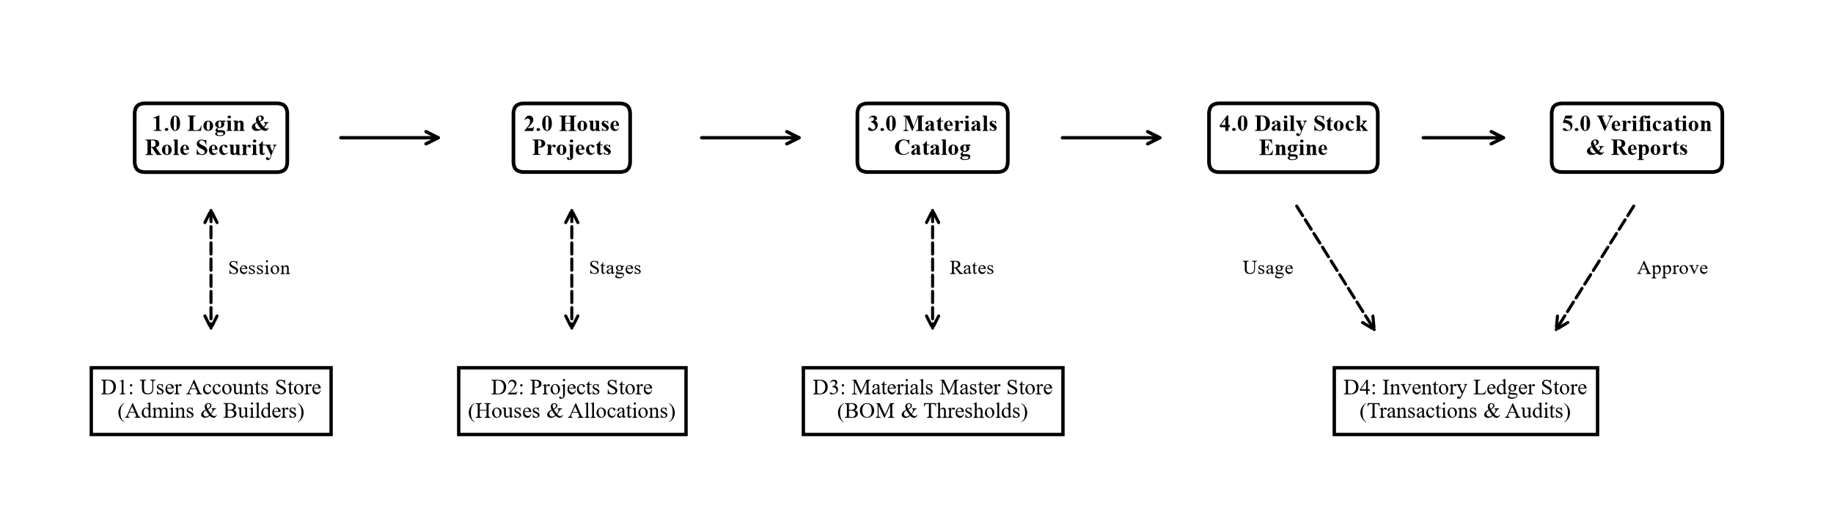
SYSTEM DESIGN
Data Flow Architecture (DFD Level 0 & Level 1)
Visualizing data movement across external actors, core processes, and database stores
CORE DATA FLOW SPECIFICATIONS
• External Entities: Four primary system actors: Project Administrator, Builder/Contractor, Site Engineer, and Material Supplier.
• Process 1.0 (Auth & RBAC): Verifies user login credentials, generates encrypted session cookies, and enforces route authorization.
• Process 2.0 (House Projects): Manages residential plot allocations, tracks 8-stage civil milestones, and computes progress percentages.
• Process 3.0 (Materials Catalog): Maintains central catalog of 95+ construction commodities with standard units, rates, and buffer levels.
• Process 4.0 (Daily Stock Engine): Processes inward supplier shipments and outward site allocations with pessimistic row locking.
• Process 5.0 (Verification & Reports): Admin queue verifies field logs, commits audit trails, and compiles multi-page PDF progress reports.
• Persistent Stores: MySQL 8.0 InnoDB tables: D1 Users, D2 Projects, D3 Materials, D4 Inventory Ledger, D5 Stages.
◆ BuildTrack – Real Estate House Building Inventory & Progress Tracker | MCA III Sem Viva Voce
9 / 18

Slide 10
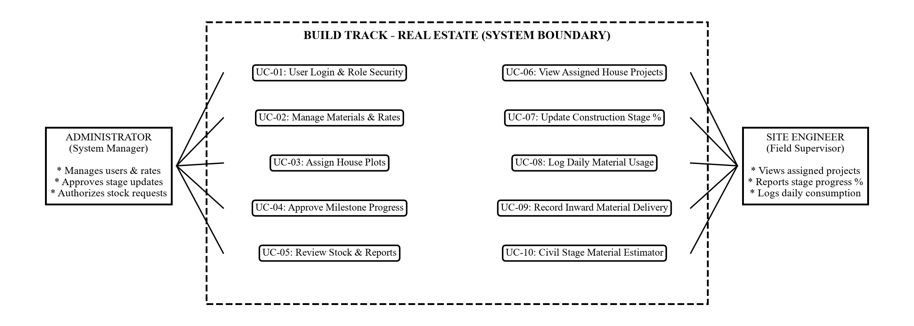
SYSTEM INTERACTIONS
UML Use Case Model & Actor Capabilities
Mapping user personas to operational functional capabilities across the system boundary
ACTOR OPERATIONAL CAPABILITIES
• Project Administrator: UC-01 Login & Role Security, UC-02 Manage Materials & Pricing, UC-03 Assign House Plots, UC-04 Approve Milestones, UC-05 Review Stock & Audit Reports.
• Site Engineer / Supervisor: UC-06 View Assigned Plots, UC-07 Update Construction Stage %, UC-08 Log Daily Usage, UC-09 Record Inward Delivery, UC-10 Civil Stage Estimator.
• Building Contractor / Owner: Monitors project progress percentage bars, reviews budget variances, inspects submitted milestone photographs, and tracks material consumption.
• Material Supplier: Submits delivery consignments, provides vehicle transit numbers, and receives digital receiving confirmations.
• UML Boundary & Relationships: Enforces <<include>> relationships for user session authentication and <<extend>> for optional WebRTC webcam snapshot capture.
◆ BuildTrack – Real Estate House Building Inventory & Progress Tracker | MCA III Sem Viva Voce
10 / 18

Slide 11
FUNCTIONAL BREAKDOWN
Architectural Structure & 3-Tier Layering
Enterprise 3-tier architecture ensuring separation of concerns, scalability, and security
PRESENTATION LAYER (Frontend & Responsive Client Views)
• Responsive UI Grid: Mobile-first 12-column Bootstrap 5 grid system adapting smoothly from 360px mobile viewports to desktop monitors.
• Jinja2 Dynamic Views: Server-rendered HTML views with auto-escaping, completely preventing Cross-Site Scripting (XSS) attacks.
• WebRTC MediaDevices API: Client-side JavaScript streaming live camera video and drawing frames to HTML5 canvas elements for JPEG compression.
• Interactive Visualizations: Chart.js hardware-accelerated canvas charts for cumulative stage progress and material consumption rates.
APPLICATION LAYER (Flask WSGI Framework & Business Logic)
• WSGI Routing Controllers: Lightweight, high-throughput Python application handling HTTP endpoints, URL parameters, and session tokens.
• RBAC Security Decorators: Custom Python decorators (@login_required, @role_required) enforcing strict role segregation at the WSGI boundary.
• ACID Concurrency Controller: Coordinates database transactions and enforces pessimistic row-level locking during simultaneous material checkouts.
• Civil Estimation Engine: Mathematical civil engineering formulas dynamically computing theoretical cement, steel, and sand quantities.
DATA PERSISTENCE LAYER (MySQL 8.0 InnoDB Engine & Storage)
• InnoDB Transactional Engine: Full ACID compliance with foreign key referential integrity constraints, write-ahead logging, and crash recovery.
• Connection Pooling: mysql.connector.pooling maintains a thread-safe pool of reusable connections, eliminating per-request connection overhead.
• Pessimistic Row Locking: SELECT ... FOR UPDATE locks specific rows during multi-step updates, eliminating race conditions and negative balances.
• Cryptographic Password Hashing: Werkzeug PBKDF2:SHA256 salted hashes guarantee that plaintext user passwords are never stored in the database.
◆ BuildTrack – Real Estate House Building Inventory & Progress Tracker | MCA III Sem Viva Voce
11 / 18

Slide 12
MODULE ARCHITECTURE
Functional Module Description & Technical Role
Detailed technical specifications for the core application subsystems
MODULE 1: USER AUTHENTICATION & RBAC
MODULE 2: HOUSING PORTFOLIO & MILESTONE TRACKER
• Role Segregation: Restricts endpoints strictly across Administrator, Builder, and Site Engineer personas.
• Cryptographic Hashing: Hashes credentials with PBKDF2:SHA256 and salt; zero plaintext storage.
• Session Integrity: Issues cryptographically signed HTTP-only cookies preventing session tampering.
• Security Interception: Intercepts unauthorized access attempts and returns HTTP 403 Forbidden redirects.
• Multi-Plot Provisioning: Registers residential plots with built-up square footage and allocated engineer.
• 8-Stage Civil Lifecycle: Structures building phases: Excavation -> Substructure -> Plinth -> Masonry -> Slab -> Finishing.
• Dynamic Recalculation: Recalculates plot completion percentage dynamically as physical milestones complete.
• Visual Progress Archive: Maintains chronological history of stage notes and live captured site photographs.
MODULE 3: MASTER MATERIALS & THRESHOLD ALERTS
MODULE 4: CONCURRENCY-SAFE ALLOCATION & WEBRTC
• 95+ Material Registry: Categorized into Cement, Steel, Bricks, Aggregates, Plumbing, Electrical, and Paints.
• Dynamic Warning Badges: Compares available stock against minimum threshold; triggers visual amber & red alerts.
• Inward Consignment Logging: Records vendor name, challan number, vehicle registration number, and photo proof.
• Unit Rate & Cost Accounting: Tracks procurement rates and computes total consignment monetary expenditures.
• Pessimistic Concurrency: Acquires SELECT ... FOR UPDATE row locks to serialize concurrent material drawdowns.
• Zero Decimal Drift: Employs Python's Decimal fixed-point arithmetic to prevent floating-point balance errors.
• WebRTC Viewfinder Capture: Integrates live device camera feed into browser canvas to snapshot site proof.
• Verification Queue: Holds site requests in 'PENDING' status until verified by administrative review.
◆ BuildTrack – Real Estate House Building Inventory & Progress Tracker | MCA III Sem Viva Voce
12 / 18

Slide 13
SOURCE CODE & IMPLEMENTATION (PART 1 OF 2)
Core Source Code – ACID Concurrency Controller
MySQL InnoDB row-level locking (SELECT ... FOR UPDATE) preventing inventory overselling in app.py
Python 3.12 / Flask – Atomic Concurrency-Safe Material Allocation (app.py)
CONCURRENCY CONTROL ARCHITECTURE
• Pessimistic Row Locking: SELECT ... FOR UPDATE locks specific material rows during the transaction, preventing parallel read-modify-write collisions.
• Zero Overselling Guarantee: Strict available_quantity validation with immediate rollback() eliminates overselling race conditions.
• ACID Persistence: MySQL InnoDB ensures that inventory deductions and project allocation records commit atomically.
@app.route('/materials/outward', methods=['POST'])
@role_required('admin')
def outward_allocation():
conn = get_db_connection()
cursor = conn.cursor(dictionary=True)
try:
mat_id = int(request.form.get('material_id'))
qty_requested = Decimal(request.form.get('quantity'))
# 1. Acquire pessimistic row-level lock on material
cursor.execute('''
SELECT material_id, available_quantity
FROM materials WHERE material_id = %s FOR UPDATE;
''', (mat_id,))
mat = cursor.fetchone()
# 2. Strict concurrency check against overselling
if not mat or Decimal(str(mat['available_quantity'])) < qty_requested:
conn.rollback() # Abort safely if stock is insufficient
flash('Allocation failed: Insufficient warehouse stock.', 'danger')
return redirect(url_for('materials'))
# 3. Deduct stock atomically within locked scope
cursor.execute('''UPDATE materials
SET available_quantity = available_quantity - %s
WHERE material_id = %s;''', (qty_requested, mat_id))
conn.commit() # Multi-table atomic success commit
flash('Material successfully issued to site.', 'success')
finally:
cursor.close(); conn.close() # Connection returned to pool
OFFICIAL GITHUB PROJECT REPOSITORY
Material allocation controller source code (app.py):
[Project Folder] github.com/.../Build Track - Real Estate Inventory Tracker
[Main Repo] https://github.com/santhoshrathinam-prog/Projects-santhosh
* Complete Repository: Live Source Code, MySQL Schema, WebRTC Camera and Reports.
◆ BuildTrack – Real Estate House Building Inventory & Progress Tracker | MCA III Sem Viva Voce
13 / 18

Slide 14
SOURCE CODE & IMPLEMENTATION (PART 2 OF 2)
Core Source Code – WebRTC Camera & Security Decorator
Hardware-accelerated camera video streaming (script.js) and role authorization (decorators.py)
JavaScript (ES6) – WebRTC Hardware Viewfinder & Capture (script.js)
CLIENT HARDWARE INTEGRATION & SECURITY
• Hardware Camera Streaming: Direct access to device cameras ensures site engineers upload authentic real-time field photos rather than pre-stored gallery images.
• Declarative Route Security: Python function decorators intercept requests at the WSGI boundary, guaranteeing role separation between Admins, Builders, and Site Engineers.
• Zero Third-Party Plugins: Native WebRTC MediaDevices API and HTML5 canvas operate universally without requiring native mobile application downloads.
// 1. Access in-browser camera hardware stream
async function startSiteCamera(viewfinderId) {
const stream = await navigator.mediaDevices.getUserMedia({
video: { width: 1280, height: 720 }, audio: false
});
document.getElementById(viewfinderId).srcObject = stream;
}
// 2. Snapshot current viewfinder frame to HTML5 Canvas
function captureSitePhoto(videoId, canvasId, inputId) {
const video = document.getElementById(videoId);
const canvas = document.getElementById(canvasId);
canvas.width = video.videoWidth || 1280; canvas.height = video.videoHeight || 720;
canvas.getContext('2d').drawImage(video, 0, 0, canvas.width, canvas.height);
// 3. Export as JPEG blob and attach to form
canvas.toBlob((blob) => {
const file = new File([blob], 'site_proof.jpg', { type: 'image/jpeg' });
const dt = new DataTransfer(); dt.items.add(file);
document.getElementById(inputId).files = dt.files;
}, 'image/jpeg', 0.92);
}
Python / Flask – Role-Based Access Control Decorator (utils/decorators.py)
OFFICIAL GITHUB PROJECT REPOSITORY
Hardware camera & security source code:
[Project Folder] github.com/.../Build Track - Real Estate Inventory Tracker
[Main Repo] https://github.com/santhoshrathinam-prog/Projects-santhosh
* Complete Repository: Live Source Code, MySQL Schema, WebRTC Camera and Reports.
def role_required(*allowed_roles):
def decorator(f):
@wraps(f)
def decorated_function(*args, **kwargs):
if 'user_id' not in session:
return redirect(url_for('login'))
user_role = session.get('role')
if user_role not in allowed_roles:
flash('Access Denied: Unauthorized route!', 'danger')
return redirect(url_for(f'{user_role}_dashboard'))
return f(*args, **kwargs)
return decorated_function
return decorator
◆ BuildTrack – Real Estate House Building Inventory & Progress Tracker | MCA III Sem Viva Voce
14 / 18

Slide 15
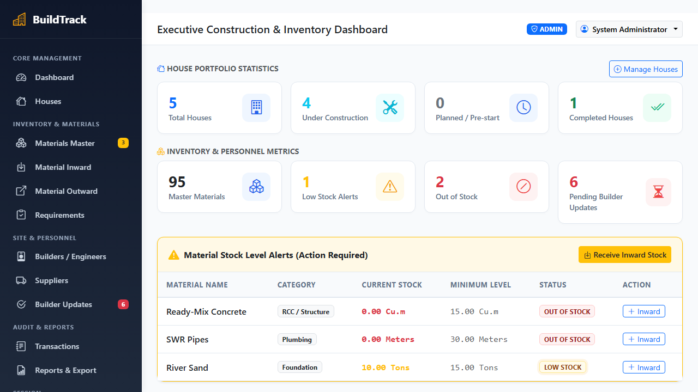
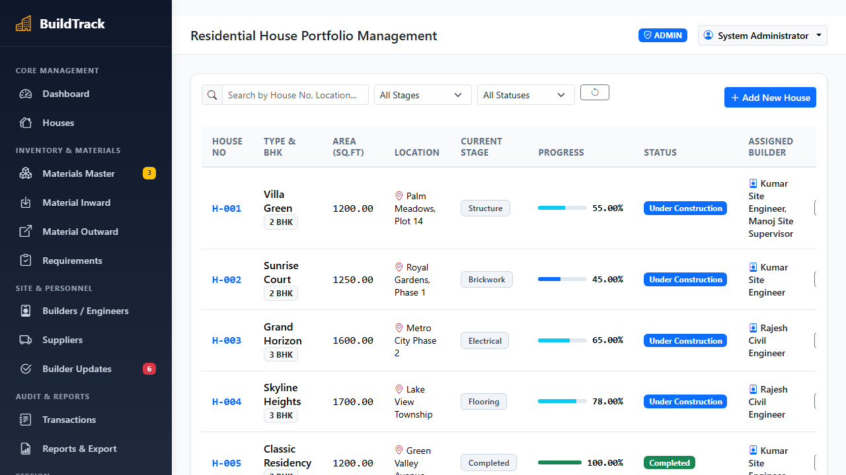
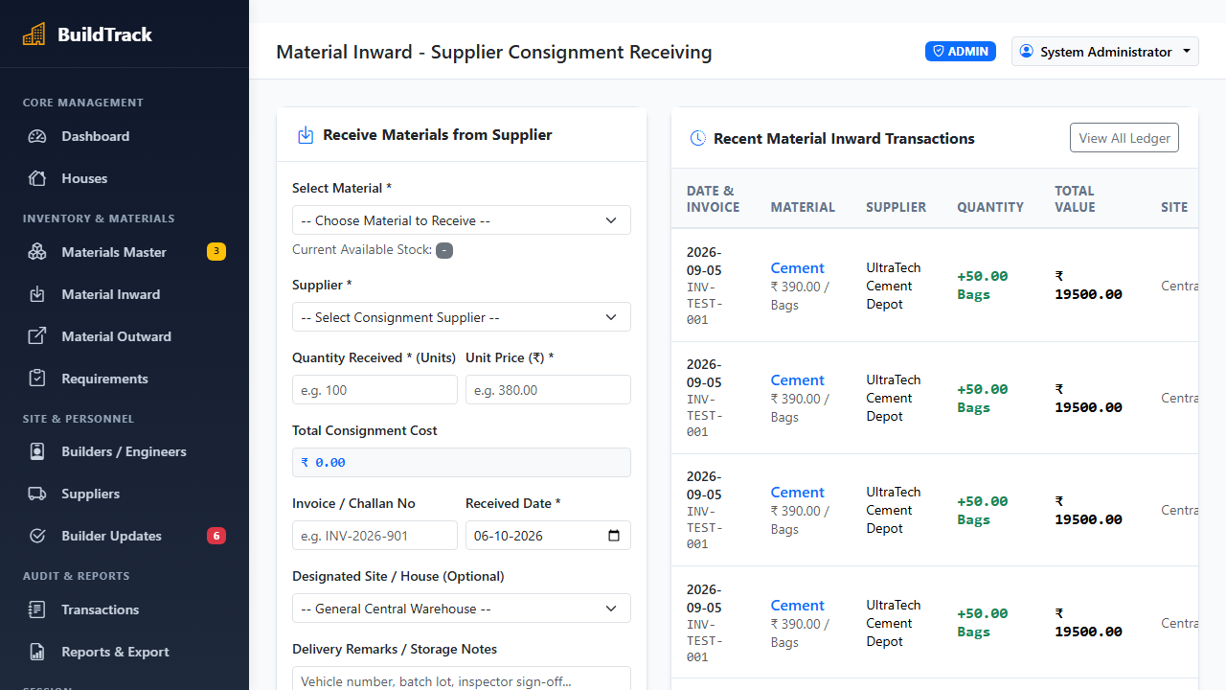
DEMONSTRATION EVIDENCE
Results and Live Screen Output
Actual user interfaces captured during operational system execution
Screen 1: Administrator Dashboard
Screen 2: House Progress Tracker
Screen 3: Material Inward Receiving
Executive KPI statistics, active housing plot counts, low-stock alerts, and pending builder verification queues.
Multi-plot construction portfolio, current structural milestone, percentage progress bars, and assigned engineers.
Supplier consignment receiving interface with challan logging, vehicle registration numbers, and photo proof.
Result Against Project Objective: Successfully verified complete end-to-end user journeys from material delivery challan intake to on-site consumption logging and photographic milestone sign-off with 100% data integrity.
◆ BuildTrack – Real Estate House Building Inventory & Progress Tracker | MCA III Sem Viva Voce
15 / 18

Slide 16
PROJECT ASSESSMENT
Conclusion and Future Scope
Project delivery summary, engineering lessons learnt, and future scalability roadmap
PROJECT SUMMARY & LESSONS LEARNT
RECOMMENDED FUTURE ENHANCEMENTS
• Centralized Inventory Governance: Successfully eliminated manual paper registers, unifying 95+ construction commodities into a single real-time ledger.
• Concurrency Resilience: Pessimistic row locking (SELECT ... FOR UPDATE) proved crucial in guaranteeing 100% stock accuracy under simulated concurrent allocations.
• Verifiable Milestone Progress: Hardware WebRTC camera integration successfully bridged site distrust by providing live, timestamped photographic evidence before stage certification.
• Practical Engineering Mastery: Gained deep practical mastery of full-stack Python Flask architecture, relational schema normalization (3NF), session security, and mobile UX.
• Offline Progressive Web App (PWA): Implement Service Workers and IndexedDB local caching, enabling site engineers to log material usage and photos even without cellular connectivity.
• Automated Barcode & RFID Gate Intake: Incorporate handheld Bluetooth or camera-based 1D/2D barcode and RFID tag scanners at warehouse gates for instantaneous check-in of palletized materials.
• AI Construction Defect Detection: Deploy lightweight computer vision models (YOLOv8) on submitted webcam photographs to automatically detect concrete honeycombing and structural cracks.
• Native Mobile App with GPS Geofencing: Develop native mobile companion apps featuring cryptographic GPS geofencing to verify that site progress photos are taken strictly within physical plot bounds.
◆ BuildTrack – Real Estate House Building Inventory & Progress Tracker | MCA III Sem Viva Voce
16 / 18

Slide 17
REFERENCES
Books, Specifications & Technology References
Authoritative textbooks and official documentation utilized in project development
BOOKS AND ACADEMIC PUBLICATIONS
TECHNOLOGY DOCUMENTATION & STANDARDS
• [1] Sommerville, Ian: Software Engineering. 10th ed., Pearson, 2015. Comprehensive textbook on software engineering lifecycle models, architectural patterns, and quality assurance.
• [2] Elmasri, Ramez, and Shamkant B. Navathe: Fundamentals of Database Systems. 7th ed., Pearson, 2016. In-depth reference on relational database normalization to 3NF and concurrency control.
• [3] Grinberg, Miguel: Flask Web Development: Developing Web Applications with Python. 2nd ed., O'Reilly Media, 2018. Essential guide for modular routing, Jinja2 templating, and user authentication.
• [4] Pressman, Roger S., and Bruce R. Maxim: Software Engineering: A Practitioner's Approach. 9th ed., McGraw-Hill, 2020. Methodological guidelines for V-Model testing and system requirements analysis.
• [5] Chacon, Scott, and Ben Straub: Pro Git: Everything You Need to Know About Git. 2nd ed., Apress, 2014. Standard guide for version control, atomic commits, and team collaboration workflows.
• Python 3.12 Official Documentation: https://docs.python.org/3.12/
Standard library, decimal arithmetic, threading, and WSGI compliance.
• Flask 3.0 API Documentation: https://flask.palletsprojects.com/
Application routing, session security, Jinja2 templating, and request handling.
• MySQL 8.0 Reference Manual: https://dev.mysql.com/doc/refman/8.0/en/
InnoDB storage engine, connection pooling, and row-level locking architecture.
• W3C Media Capture Streams API: https://www.w3.org/TR/mediacapture-streams/
HTML5 WebRTC standard for client-side webcam streaming and photo capture.
• Bootstrap 5.3 Responsive Framework: https://getbootstrap.com/docs/5.3/
Responsive 12-column mobile-first grid system and UI component architecture.
◆ BuildTrack – Real Estate House Building Inventory & Progress Tracker | MCA III Sem Viva Voce
17 / 18

Slide 18
BUILD TRACK – REAL ESTATE HOUSE BUILDING INVENTORY & PROGRESS TRACKER
THANK YOU
QUESTIONS & VIVA VOCE DISCUSSION
We welcome questions, suggestions, and feedback on the project architecture,
concurrency control models, and software engineering implementation.
NAME OF STUDENT : SANTHOSH RATHINAM M
ENROLMENT NUMBER : EA2532251010685
MASTER OF COMPUTER APPLICATIONS (MCA - III SEMESTER)
Directorate of Online Education, SRM Institute of Science and Technology
OFFICIAL GITHUB PROJECT REPOSITORY
Direct links to official repository and project source folder on GitHub:
[Project Folder] https://github.com/santhoshrathinam-prog/Projects-santhosh/tree/main/Build%20Track%20-%20Real%20Estate%20House%20Building%20Inventory%20and%20Progress%20Tracker
[Main Repo] https://github.com/santhoshrathinam-prog/Projects-santhosh
* Complete Repository: Live Source Code, MySQL Schema, WebRTC Camera and Reports.

